Slide 1
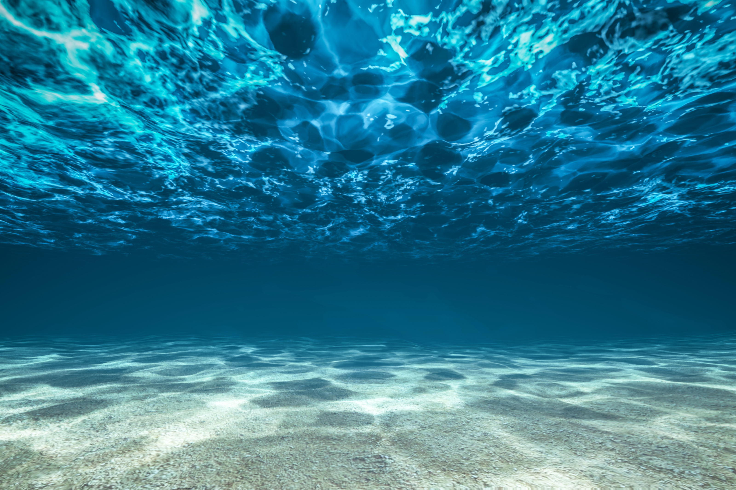
Testbed for underwater communication
Felipe Bahamondes, Mathias Markvardsen, Morten Henriksen

Slide 2

Guess a message!
Answer: ”Hello_there”

Slide 3
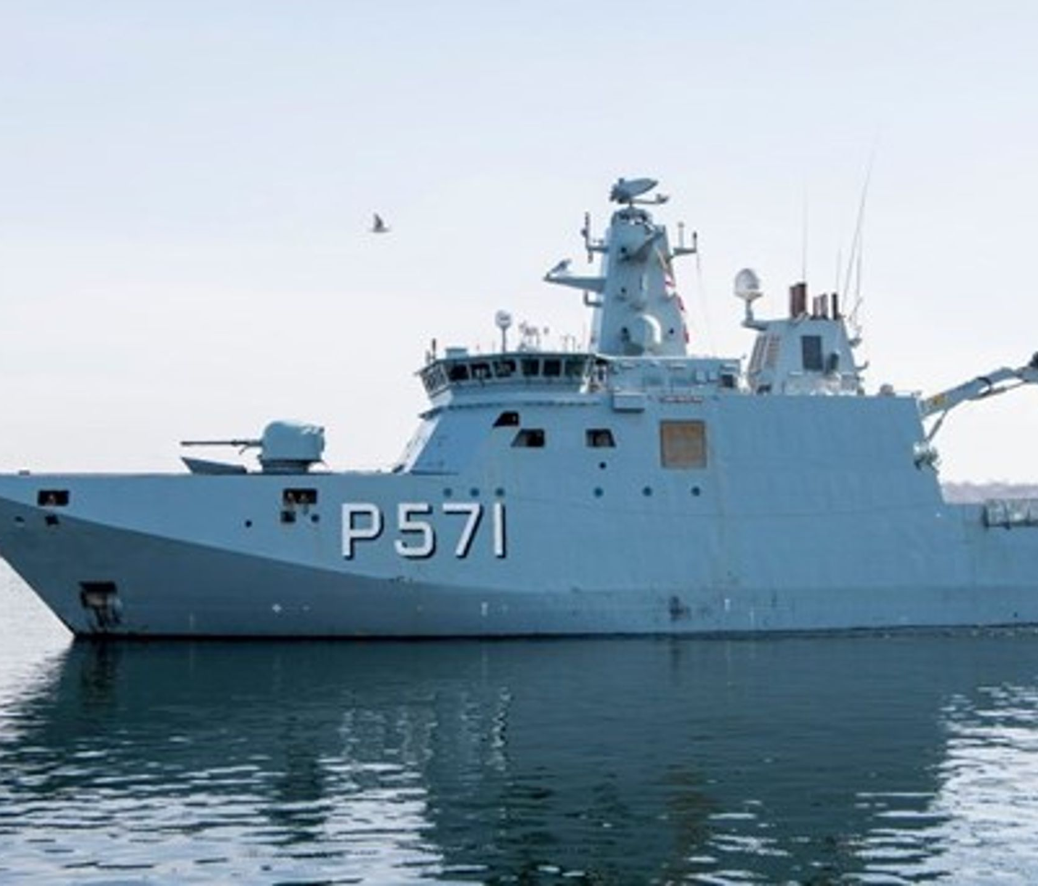
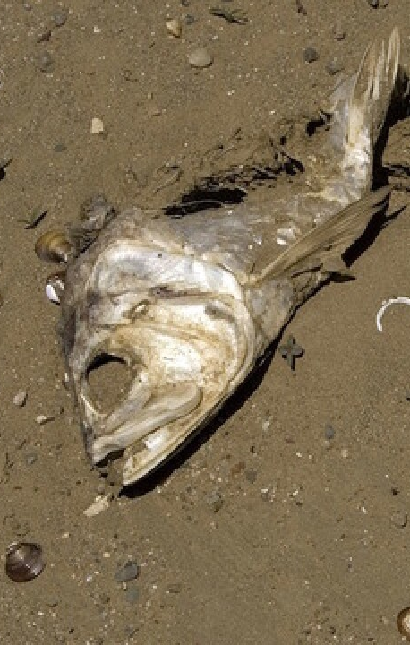
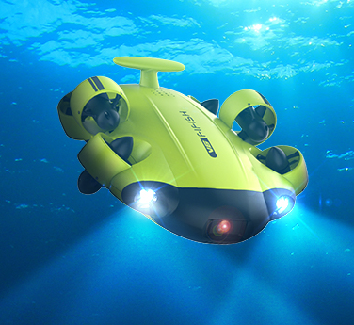
Project Details
Bachelor project
“The aim of this project is to design and implement a basic underwater communication system that can transmit data from an underwater speaker to a hydrophone receiver…”
A lot of freedom to choose
No prior knowledge
3 software students, who liked math and programming

Slide 4
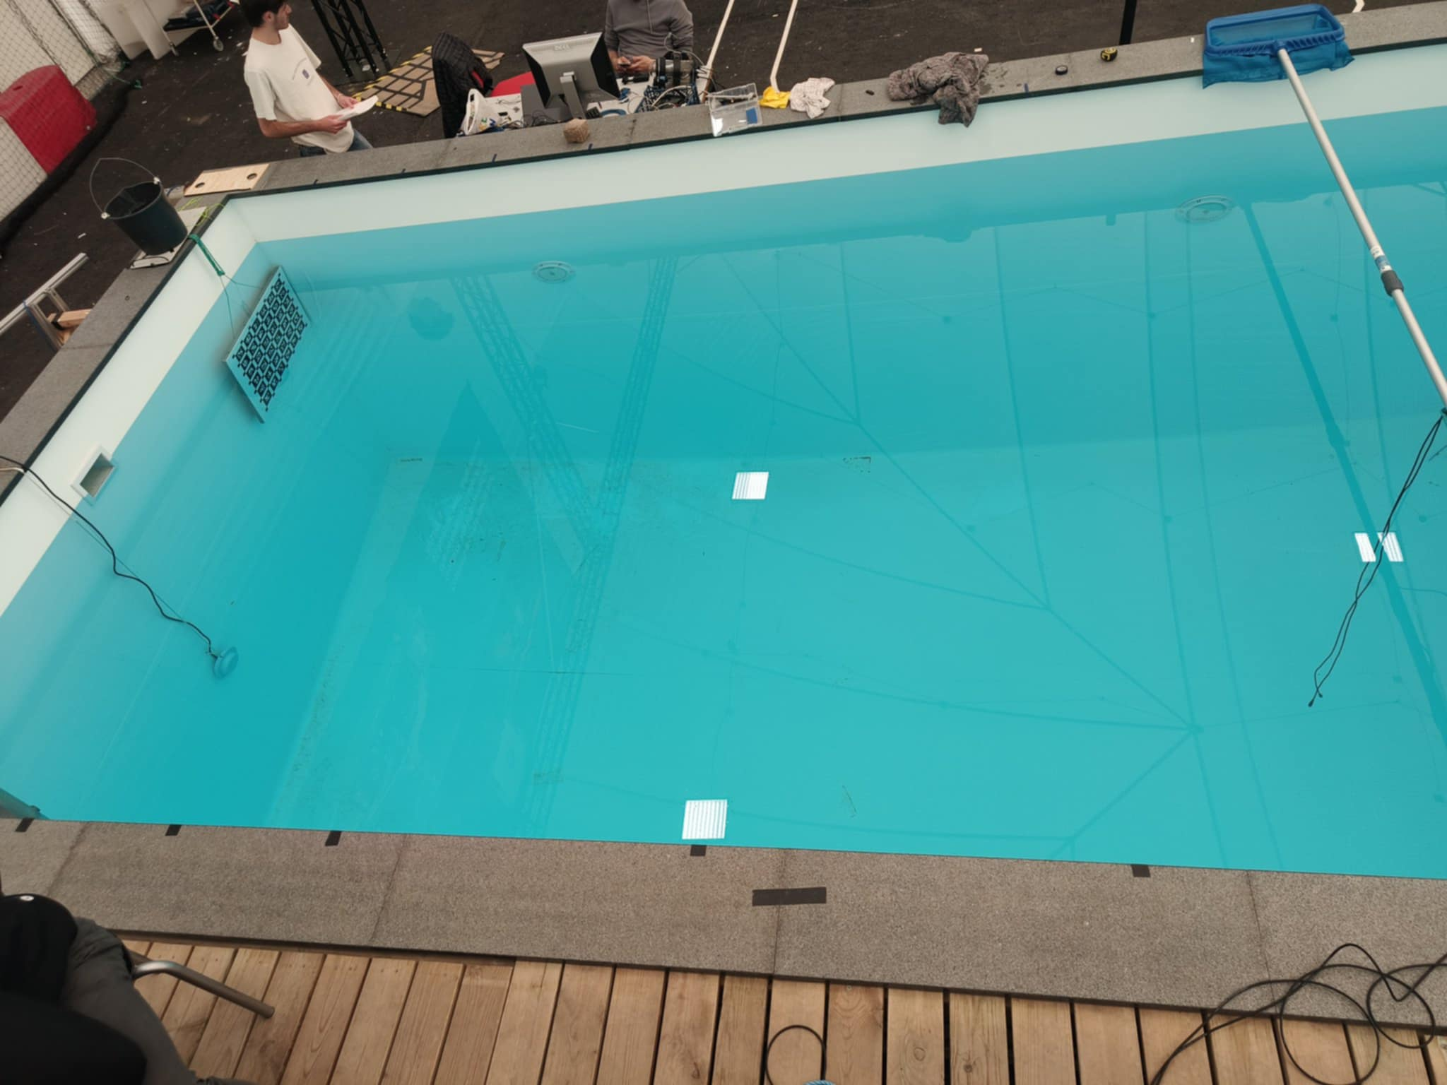
The Pool
Speaker
Hydrophone
2 m
5 meters

Slide 5
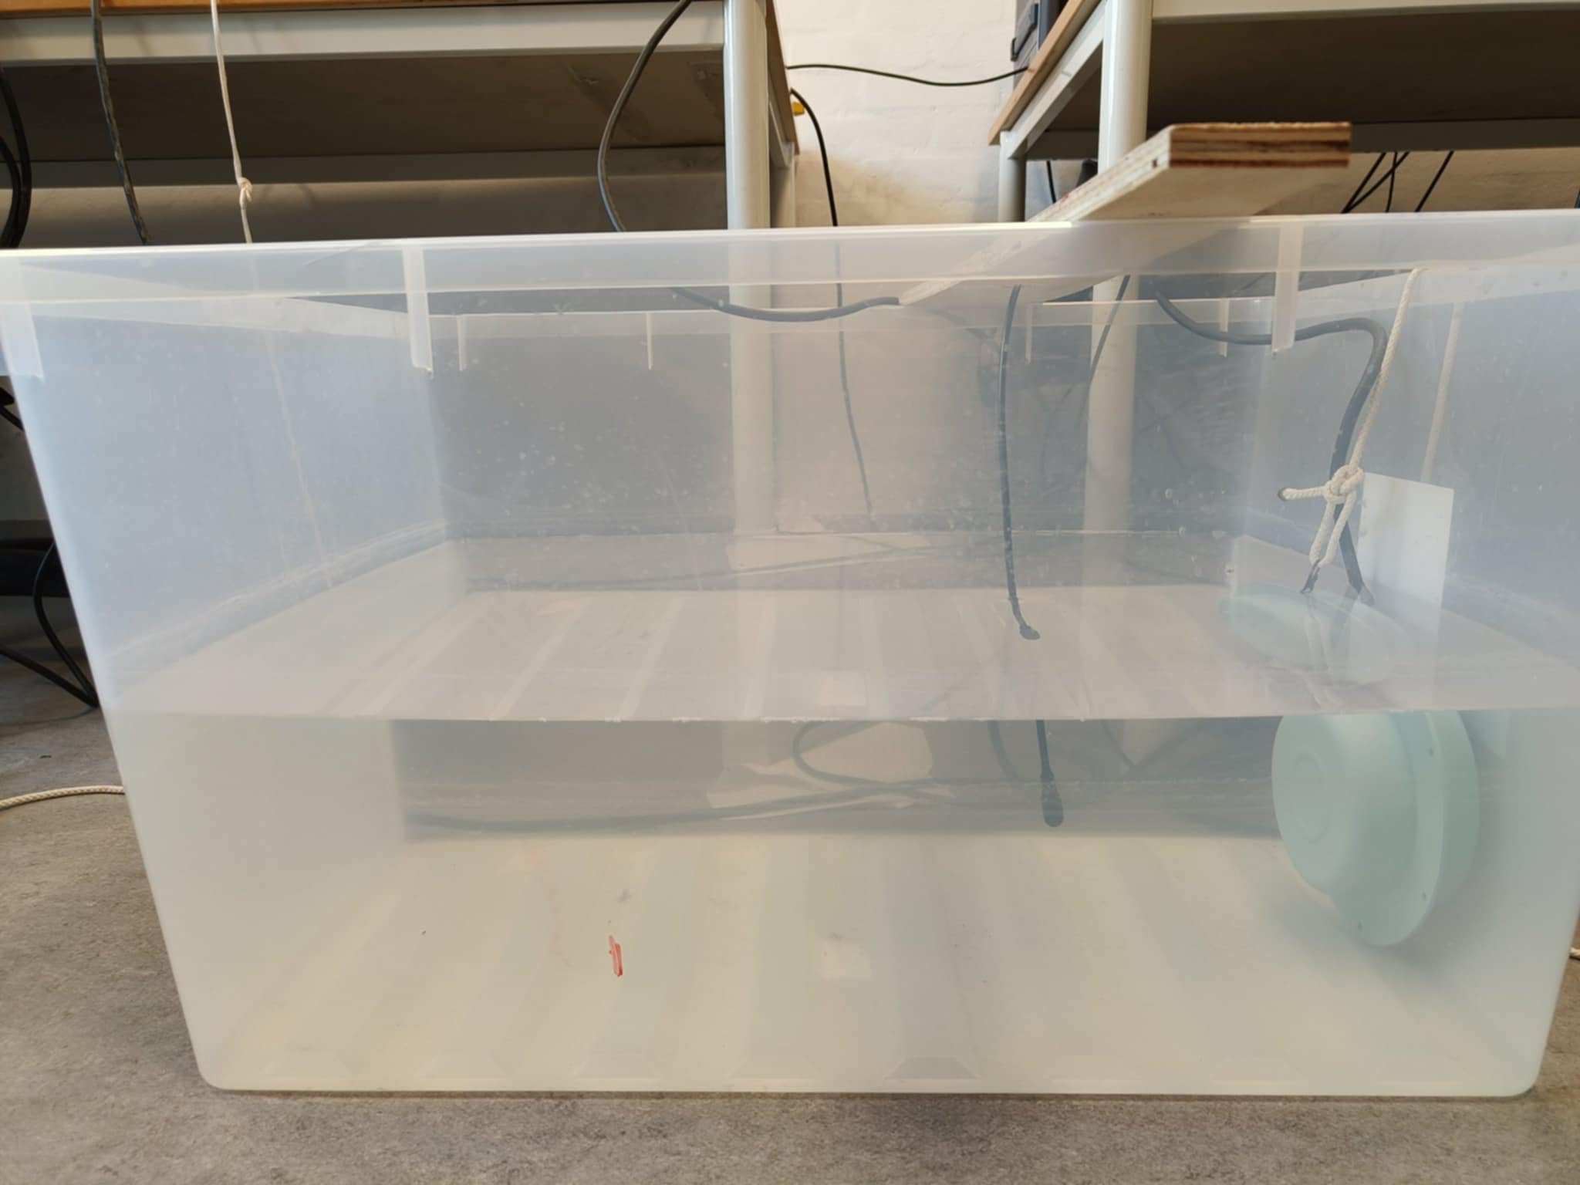
The Plastic Tank
Speaker
Hydrophone

Slide 6
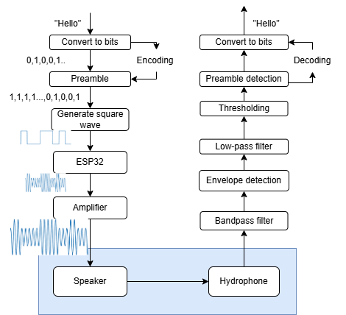
Protocol

Slide 7
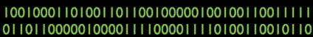
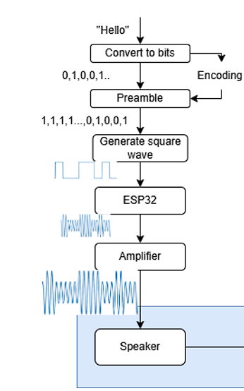
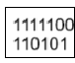
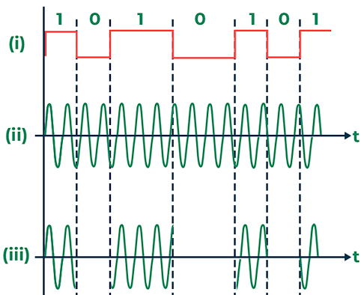
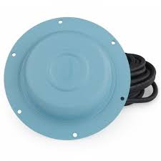
Transmitter

Slide 8
Reciever side
WAV.file (show pure recording) ->
bandpass filter (show what it does)->
Envelope detection ->
Normalize ->
Threshholding (converting signal to bit) ->
Preamble detection ->
Message

Slide 9
Results

Slide 10
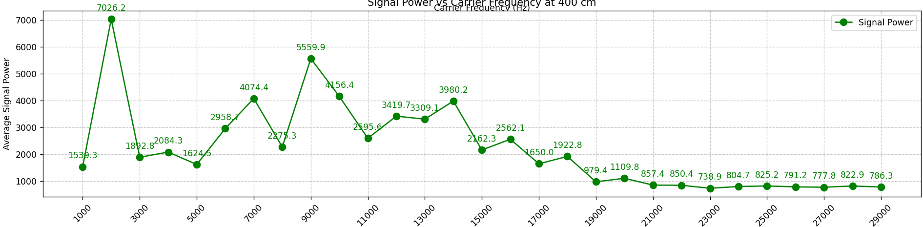
ATTENUATION
Average power vs. Carrier Frequency

Slide 11
INTERFERENS
ADD REVERSE PLOT OF THE PREVIOUS

Slide 12
And many others:

Slide 13
ADD LINE OVER HOW WELL THE SYSTEM RECEIVES COMPARED TO OTHER KNOWN STUFF

Slide 14
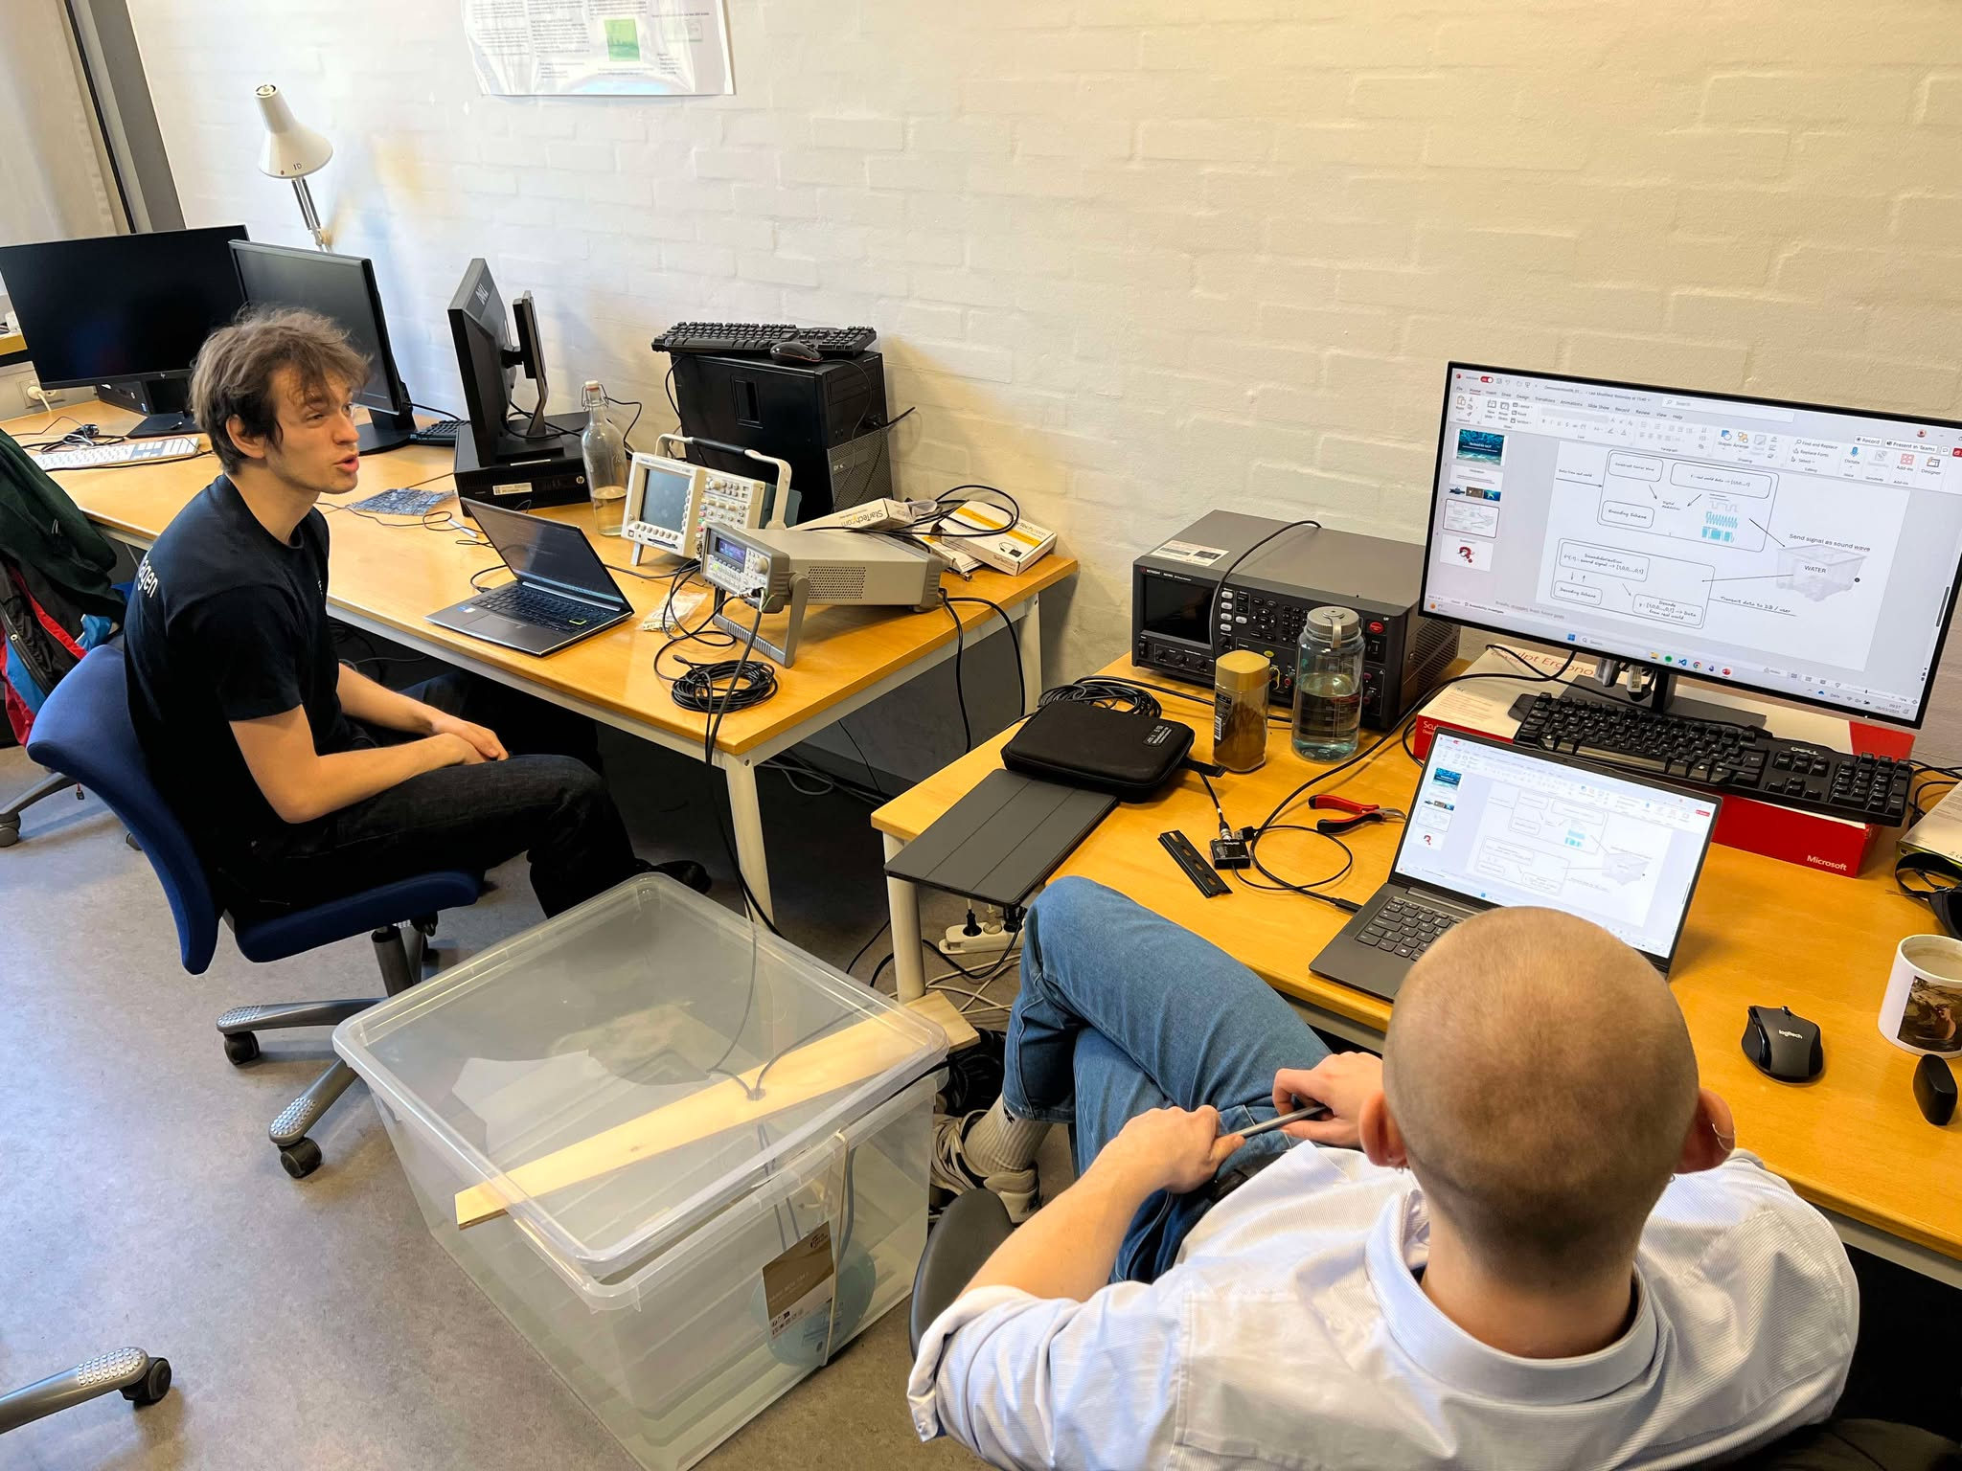
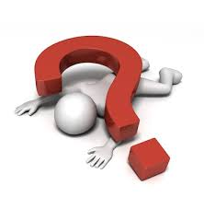
Questions?

